Slide 1

Graduation
Class of 2027

Slide 2
topics
Graduation requirements
Post high school options
Transcript Services
Upcoming events
Post-secondary Education & University Applications
Scholarships

Slide 3
Graduation Requirements
80 credits: All courses are 4 credits each
REQUIRED COURSES
Minimum 52 credits
English 10
Science 10
A Math 10
Physical and Health Education
Socials 10
Career Life Education
English 11
Socials 11 or 12
A Math 11 or 12
Science 11 or 12
English Studies 12 / English First Peoples 12
Fine Arts or Applied Skill / Design 10, 11, 12
CLC A and Capstone Project
MIMIMUM Additional Courses
Total Electives must be 28 credits
(Must include 3 Grade 12 subjects)
MUST COMPLETE NUMERACY AND
LITERACY ASSESSMENTS

Slide 4
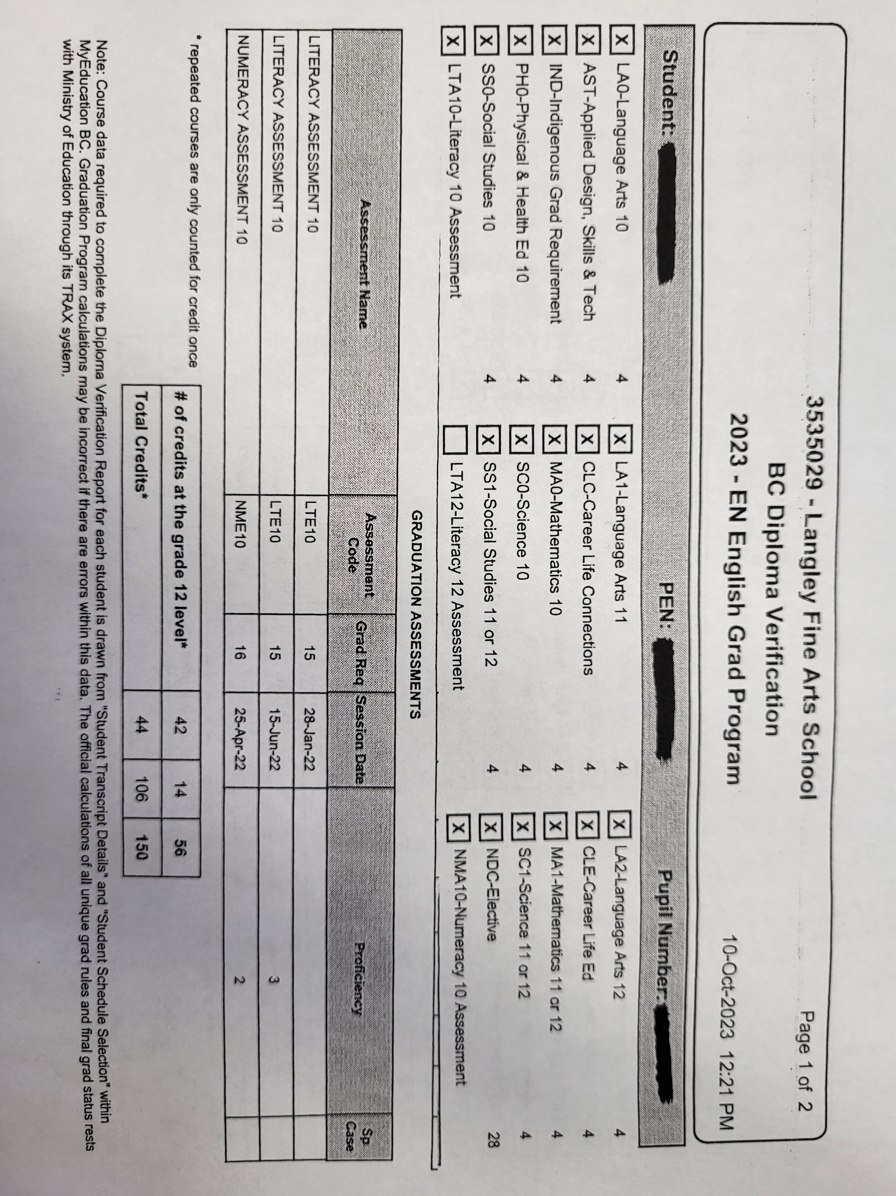
Diploma Verification Report

Slide 5
High school graduation
Military/
Policing
University/
College
Intentional Gap year
Employment/
Run own business
Travel/
Volunteer
Apprenticeship
Skilled Trades
Work

Slide 6
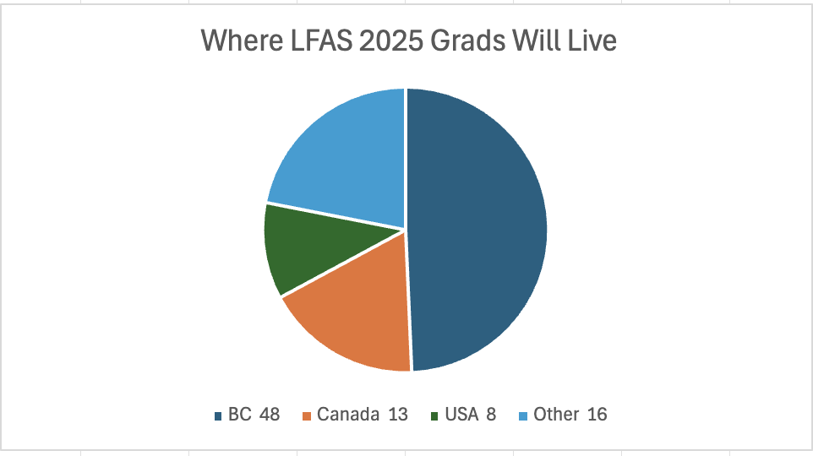
Graduate Demographics

Slide 7
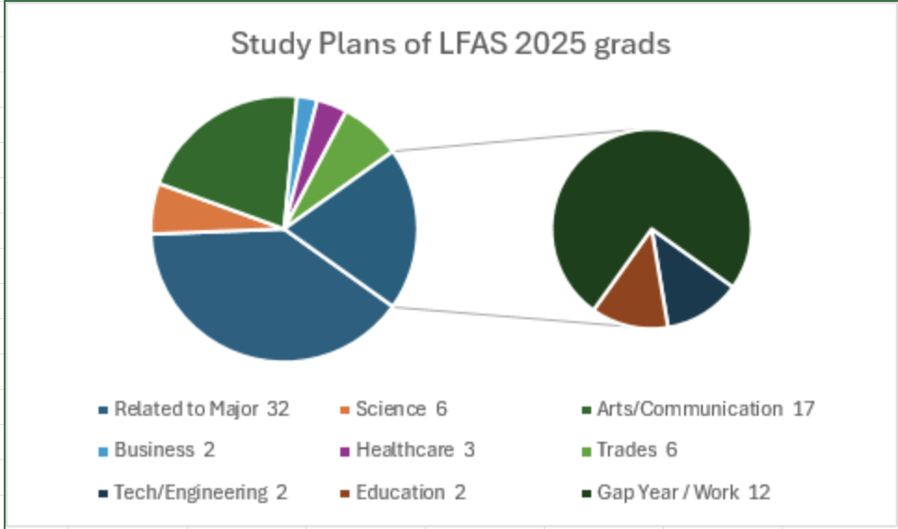
Class of 2025 Survey
Top schools: UBC, SFU, UFV, KPU, CAPU, TWU and UVIC

Slide 8

Transcript Services
https://www.studenttranscripts.gov.bc.ca/
View or order your transcript
Send your secondary school transcripts to post-secondary institutions
Order your graduation certificate
View scholarships awarded by B.C.
View your provincial exam or graduation assessment results
**Instructions for signing up with Transcript Service, ordering and sending transcripts will be posted on Teams – Career & Counselling Info**

Slide 9
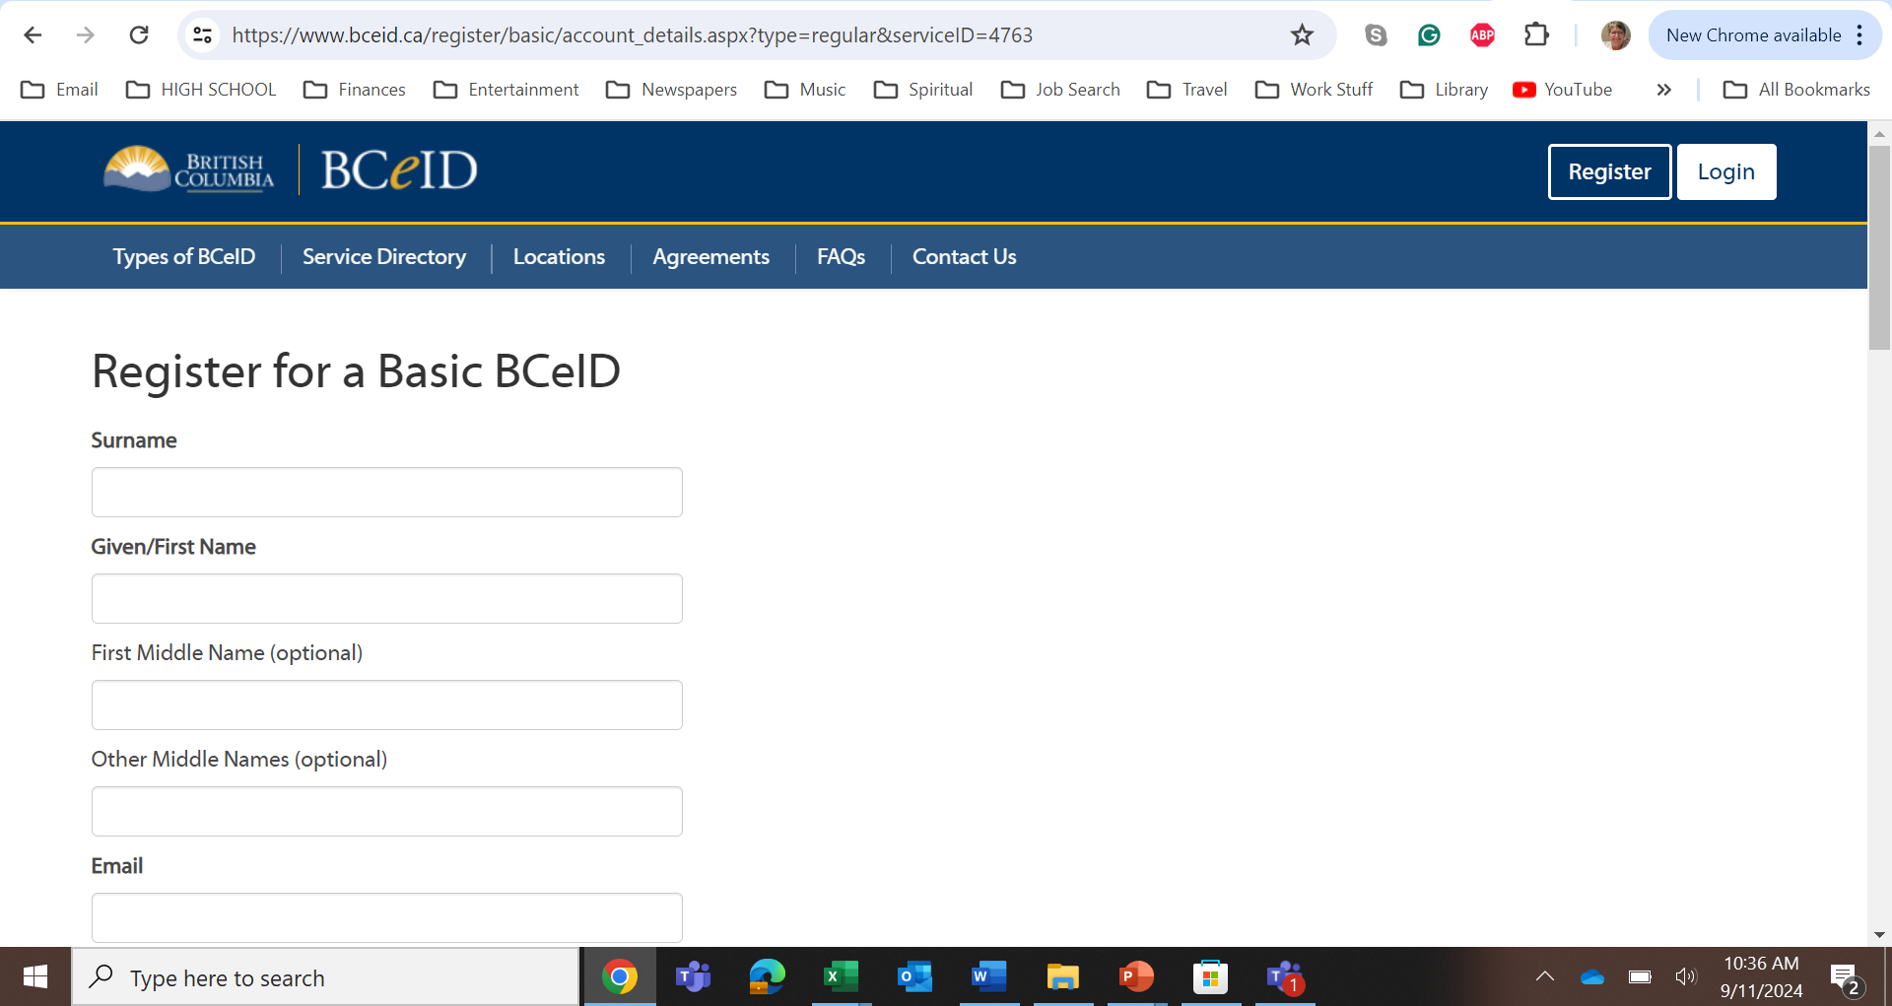
STUDENT TRANSCRIPT SERVICES REQUIRE YOU TO REGISTER FOR BCEID
What you'll need
Your Personal Education Number (PEN)
A valid email address
Your date of birth
Your legal first and last name

Slide 10
Student Transcript services
As a current student, you receive for free:
Up to 25 transcripts sent to post-secondary institutions on your behalf
One printed, mailed transcript sent to a third party (e.g. to yourself or an employer)
One graduation certificate from your school
Confirmation e-mail
*Any additional transcripts or certificates cost $10 each.
**Some institutions don’t use Student Transcript Service (STS) for transcripts, such as BCIT. They will request a physical copy or scanned transcript sent by you or the school.
Talk to Mr. Hofbauer or Ms. Lee to request a printed transcript.**

Slide 11
Canadian
Education
System
Graduate
programs
Undergraduate programs
Notes:
AD = Associate Degree

Slide 12
Post-secondary Education Programs
Certificate: 1 day to 1 year Diploma: 1-3 years
University Transfer: https://www.bctransferguide.ca/
Associate Degree: 2 years, credits are transferrable to other institutions
Red Seal / Skilled Trade Certificate: 2 – 4 years
Bachelor’s Degree: 3-4 years
Master’s Degree: 1-3 years Professional Degree: Law – 3 years Doctorate: varies Post Doctoral: varies
Notes:
Certificate: 4 month to 1 year - Accounting, Early Child Education Certificate, Health Care Assistant, Medical Office Assistant, Dental Assistant, Lab Assistant, Legal Assistant
Diploma: 1-2 years – Aircraft Maintenance, Interior Design, Fashion Design & Production, Sign Language Interpretation, 3D Animation, Veterinary Technology
Associate Degree: 2 years, credits are transferrable to other institutions
University Transfer: 1 – 2 years, Engineering, Arts, Science, Business
Red Seal / Skilled Trade Certificate: 2 – 4 years – Electrician, Plumber, Carpenter, Hairstylist
Bachelor’s Degree: 3-4 years
Master’s Degree: 1-3 years; Counselling Psychology, Physical Therapy, Social Work, Education
Professional Degree: Law – 3 years, Medicine & Dental - 4 years
Doctorate: varies
Post Doctoral: varies

Slide 13
University/College
Public Research University：
UBC，SFU，UVic, U of T, McGill, Waterloo
Public Teaching University:
KPU, UFV, BCIT, TRU, UNBC, VIU, Capilano, Emily Carr
Public College/Community College:
VCC, Douglas, Langara, Camosun, Okanagan College
Royal Military College
Private University:
Trinity Western University, Corpus Christi
Private College:
Sprott Shaw College, Sternberg College, CDI College, Columbia College
Career & Vocational Training Institution:
Vancouver Film School, AAA Aviation Flight Academy, Academy of Learning
Notes:
A certificate generally requires one year of full-time study at a college or vocational institute while a diploma generally requires two years of full-time study at the same type of institute. Some schools also offer advanced diplomas, which require the completion of at least three years of full-time study.

Slide 14


How to choose your path forward
Know Yourself
Research
Urban or small town
Interests / Passions
Comfort level re debt
Learning style
Lifestyle
Income expectations
Location
Program
Cost
Teaching style / class size
Reputation
Extracurriculars

Slide 15
University/College Admission Requirements
General requirements (CHECK SPECIFIC PROGRAMS):
  Graduate from high school
  Research Universities: English 12 + another 3 to 5 G12 courses, minimum marks
  Teaching Universities/College: English 12, minimum marks
  English language requirements
  Science programs require 2 of 3 G12 Science courses
  Math requirement: Pre-Calculus 12, some university programs ask for Calculus 12
  UBC requires Proficient G12 Literacy Assessment (3 or 4)
  Uvic, TWU, Langara and SFU require completion of Literacy and/or Numeracy Assessments, but scores will not be used for admission.

Slide 16
Special Requirements
Programs and Schools have different processes and requirements.
  UBC – No Language 11 required.
  SFU – Still required for 2026, NOT 2027!
  Language 11 Challenge Exam: apply to Mr. Hofbauer
  For English Waiver: Talk to Mr. Hofbauer if you came to Canada after Grade 9
  UBC: Personal profile (application essay)
  Program-specified: Supplementary documents
  UBC Sauder School of Business: Video interview
  Fine Arts programs: Portfolio
  Nursing: Check specific program
  Music & Theatre: Audition
International students!

Slide 17
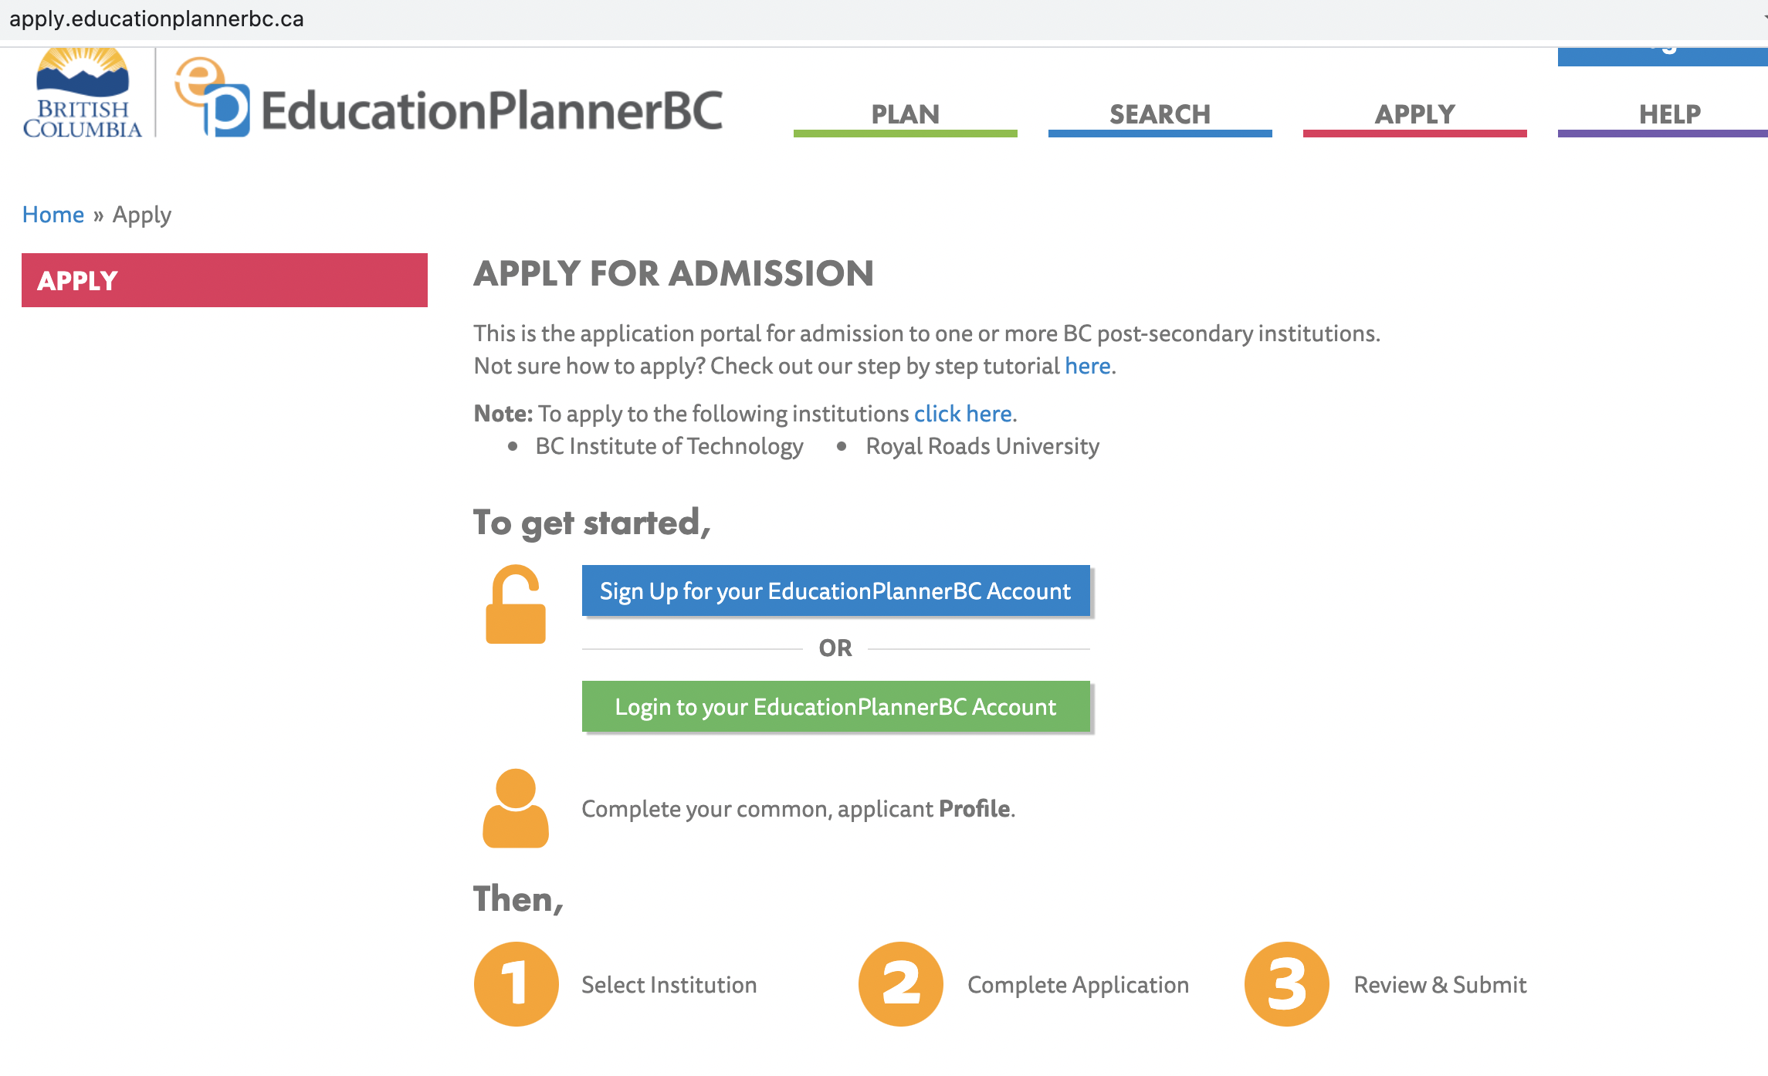
University/College Application
Before application:
Select programs and schools
- School: Pick 3-5
- Program of Study: 1st choice and 2nd choice; undecided; Faculty only
For BC universities (except BCIT):
Apply through education planner:
https://www.educationplannerbc.ca/

Slide 18
For other provinces and USA
  Apply Alberta
  https://www.applyalberta.ca/about-applyalberta/
  OUAC (Ontario Universities’ Application Centre)
  https://www.ouac.on.ca/
  Common App for USA universities
  https://www.commonapp.org
  School websites

Slide 19
BC Universities |  |  | Other than BC universities
School | Admission Deadline | Scholarship Deadline | School | Admission Deadline | Scholarship Deadline
UBC First Round Dec 1 Dec. 1 Regular: Jan. 15 Must tick box |  |  | U of T Early: Nov 7 Oct 16 Regular: Jan 15
SFU Jan. 31 Apply by Dec. 15 |  |  | McGill Jan. 15 Feb 7
Emily Carr Jan. 15 Automatic |  |  | McMaster Jan. 15 Automatic++
UVic Jan. 31 Automatic |  |  | U of Alberta Mar. 1 Jan. 10
TWU Feb 15 Automatic |  |  | Waterloo Feb. 1 Automatic++ Jan 15 (Engineering)
Capilano Mar. 31 Apply by March 1 |  |  | SCHOLARSHIPS CAN BE AUTOMATIC AND/OR A SEPARATE APPLICATION
  **U of T “ “Applicants who submit required documents early are able to maximize their opportunities for admission consideration. Documents received after the published deadlines will be considered as space allows.”
Notes:
Check out the dates

Slide 20
  Open Intake/Enrolment
  First-qualified, first-admitted, rolling admission until programs fill or posted dates. Early application recommended.
  Limited Intake/Enrolment
  Limited seats. Deadline is flexible. Applications close once program fills.
  Douglas: Open Enrolment – until class starts
  KPU: Limited Intake Deadline: March 1 Open Intake: July 1
  BCIT: Varies
  UFV: Continuous application process

Slide 21
University/College Application
Watch Deadlines for Document Submission
  Not the same as application deadlines
  Self-report Transcript: upon request of the institution
  Other documents: upon request of the institution and follow instructions
  Scholarship documents
Communicate with University/College
  Before application
  - Email or phone Admission Offices
  After application
    Your personal email
    Student Account: create an account, student number assigned to you when you apply, student email account, messages and notifications, application for residence, etc

Slide 22
School and Program exploration/Application
Education Planner BC: https://www.educationplannerbc.ca/search
Post-secondary BC: https://www.postsecondarybc.ca/
Ontario University Info: https://www.ontariouniversitiesinfo.ca/universities
Ontario University Application: https://www.ouac.on.ca/
Ontario Colleges: https://www.ontariocolleges.ca/en/colleges
Apply Alberta: https://www.applyalberta.ca/about-applyalberta/
School websites: www.ubc.ca, www.sfu.ca & more
BC Transfer Guide: https://www.bctransferguide.ca/ (transfer between institutions)

Slide 23
CAREER NEWS
Career Center (Portable 7)
Open: Mondays, Tuesdays, Wednesdays
​

Slide 24
Graduation Transition Meetings
Grad transition conversation – sample questions:
What is your plan after graduation?
How far along you are in the process for your University/College applications?
What challenges are you facing or expect to face when you graduate?
Before you leave Langley Fine Arts you need to have
30 volunteer hours.

Slide 25

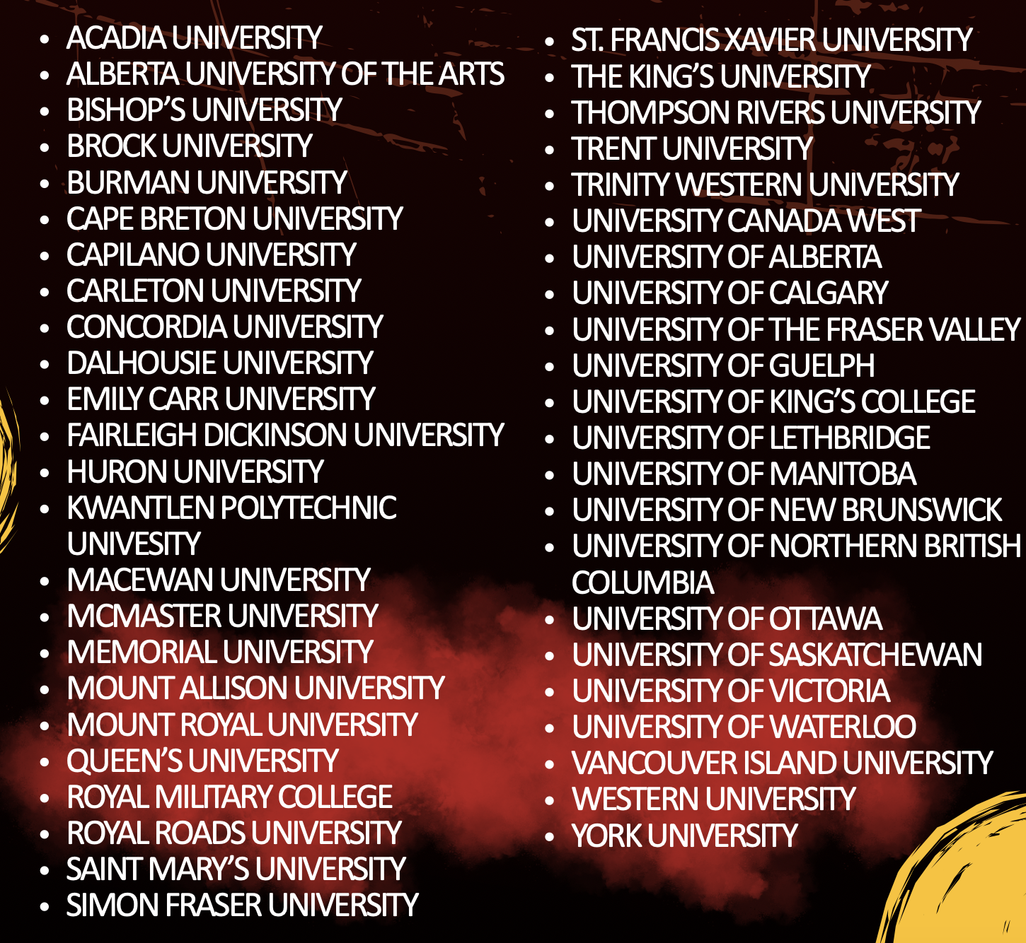

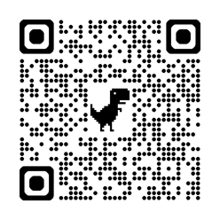
Canadian
Universities Event
Not sure where to begin?
Date: October 7, 2026
Time: to be determined
Venue: Langley Event Centre
Limited seats.

Slide 26
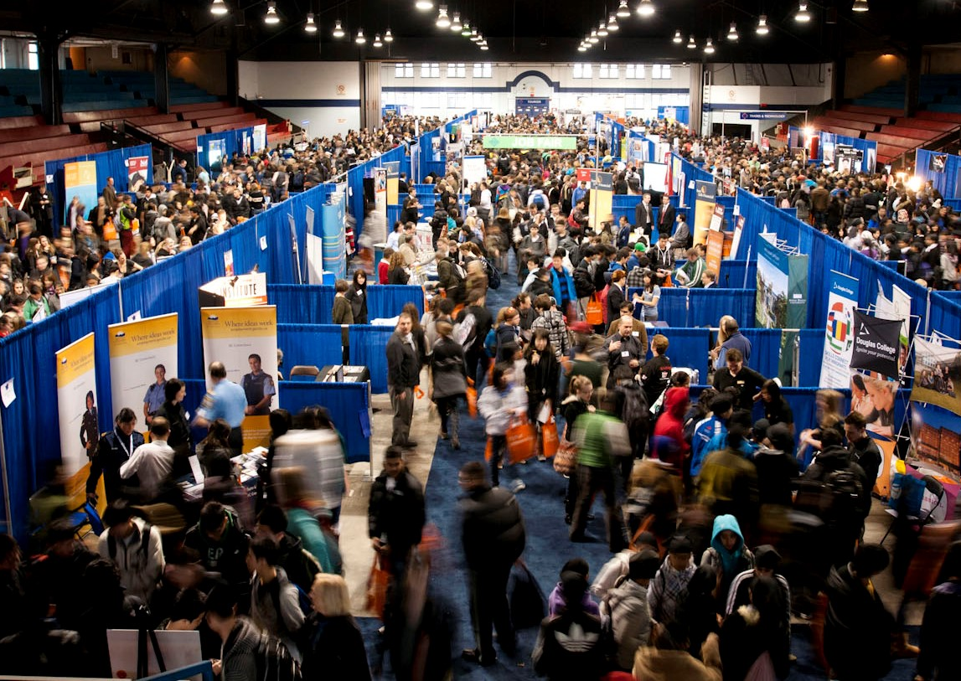
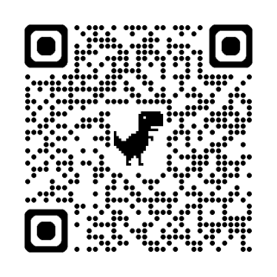
Post Secondary BC Fair/Presentations
Date: October 29
Time: 1:10 – 3:05 PM
Institutions attending:
Capilano Univ.
Emily Carr
Farleigh Dickinson
Kwantlen Univ.
Langara College
SFU
UVIC
VCC ...
(12 –15 attending)

Slide 27

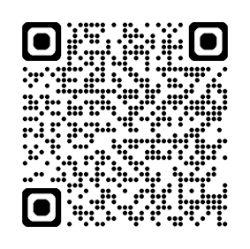
Discovery Day @
BC Children's Hospital – Nov 6 | 8:00 – 2:30 PM
Discovery Days in Health Sciences provide students with the opportunity to explore a variety of career options in Medicine and the Health Sciences.
One-day event includes:
Interactive workshops
Panel discussion about careers in health
Networking opportunities

Slide 28
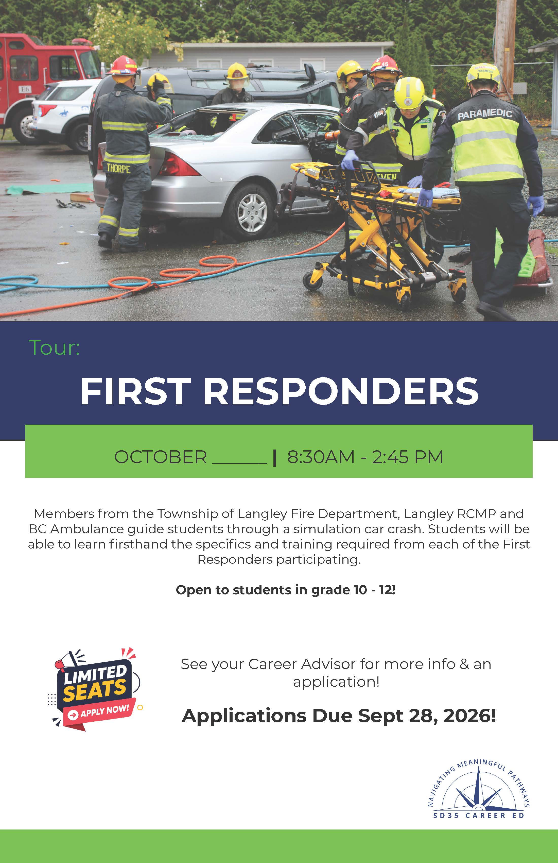
First Responders Tour
Members from the TOL Fire Department, Langley RCMP, and
BC Ambulance will guide students through a car crash simulation.
Date: TBD (Oct 6, 7, or 8)
Time: 8:30 – 2:45 PM
Limited seats. Apply early.

Slide 29
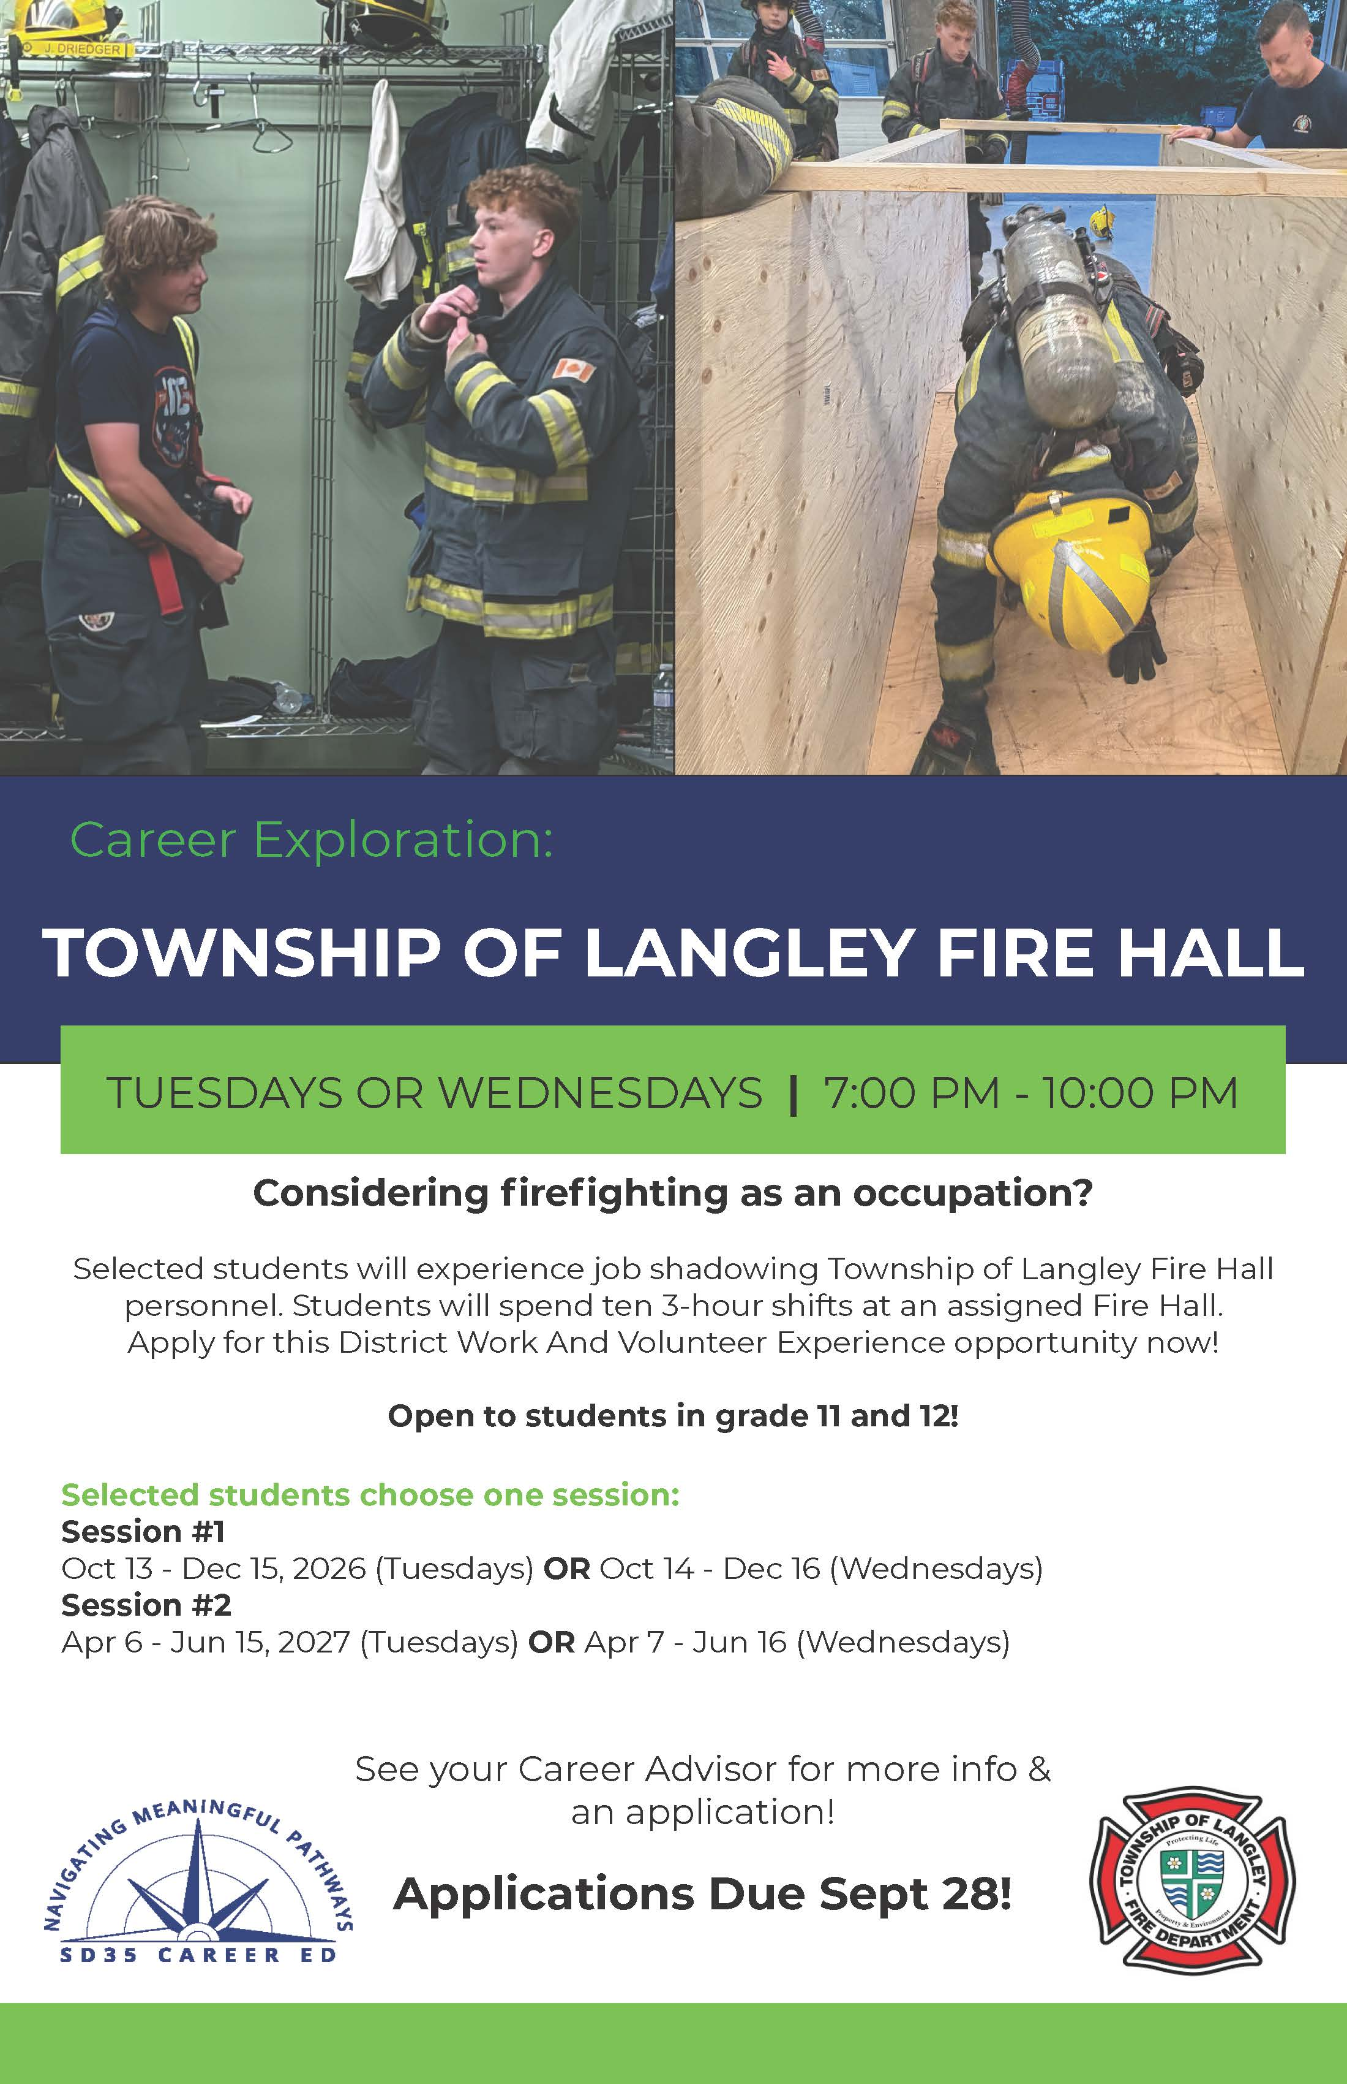
Township of Langley Fire Hall
District Work and Volunteer Experience!
Students will experience ten 3-hour shifts job shadowing Township of Langley Fire Hall personnel.
Applications due: Mon, Sept 28

Slide 30
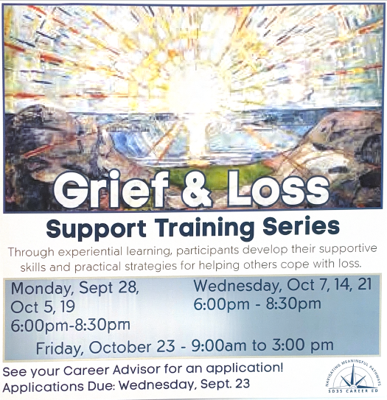
Grief & Loss Support Training
For students interested in pursuing careers in Nursing, Counselling, Social Work, First Responders, Educators.​
Evenings 6:00 – 8:30​ PM
1. Mondays: Sept 28 – Oct 5, 19​
2. Wednesdays: Oct 7, 14, 21​
​
All day 9:00 – 3:00 PM​
Friday, Oct 23​
Applications due: Wed, Sept 23​
​

Slide 31


Financial Aid
Scholarship – Monetary award for excellence in an area
Bursary – Grant based on evidence of financial needs
Award – Competition or recognition of accomplishment
Student Loan – Repayable financial assistance

Slide 32
Scholarships
Provincial Scholarships
Langley School District Scholarships
Langley Fine Arts School Scholarships
University/College Entrance Scholarships
Other Scholarships offered by University/College
Community Scholarships
Scholarship offered by employers

Slide 33
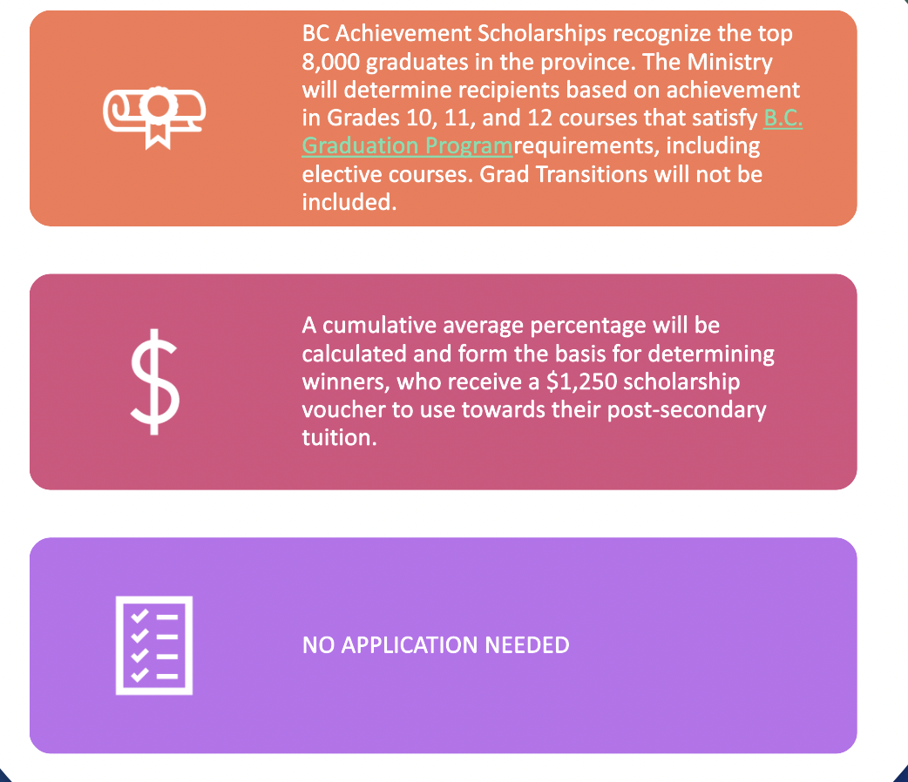
PROVINCIAL
SCHOLARSHIP
BC Achievement

Slide 34
PROVINCIAL SCHOLARSHIP: BC Excellence
Awarded to 55 high school graduates in BC who have demonstrated service and leadership, and who
show aptitude for and commitment to their chosen career paths.
$5,000 scholarship voucher
to be reimbursed by the Ministry of Education for tuition
paid after attending a designated post-secondary institution or B.C. authorized trades training provider
5 years to redeem
- Expiry date is printed on each voucher –NO EXTENSIONS.
**Nominated by school and sent directly to the Ministry**
Notes:
The BC Excellence scholarship is awarded to 55 well-rounded high school graduates who have demonstrated service and leadership, both at school and in their communities, and who show aptitude for and commitment to their chosen career paths.
Recipients receive a $5,000 scholarship voucher that they can use to be reimbursed by the Ministry of Education for tuition paid after they are attending a designated post-secondary institution or B.C. authorized trades training provider.
Students have five years to redeem their BC Excellence scholarship vouchers; an expiry date is printed on each voucher and extensions are not possible.

Slide 35
PROVINCIAL SCHOLARSHIP: District Authority
::
5,500 District/Authority Scholarships across the province
$1,250 scholarship voucher to use towards their post-secondary tuition.
Recognizes graduating B.C. students for excellence in their chosen area of interest or strength.
Selection Criteria: GPA and Reference from Major Teacher
GPA is calculated on Eng. 11, Eng. 12, Math 11/12, Social Studies 11/12, Science 11/12 along with other top 7 courses in Grade 11 and 12.
**Apply along with LFAS & Langley District Scholarships.
Application Form will be available in January and due on Feb. 27, 2026.**

Slide 36
Langley district scholarship
Open to all graduates in Langley School District. $100 - $2500.
Selection criteria:
GPA
Involvement in fine arts, community service, leadership activities, membership/affiliation with specified groups, financial needs, etc.
*More details will be available in the Application Package.
GPA is calculated on Eng. 11, Eng. 12, Math 11/12, Social Studies 11/12, Science 11/12 along with other top 7 courses in Grade 11 and 12.
**Apply along with LFAS Scholarship, District Authority, Application Form will be available in January and due on Feb. 27, 2026. **

Slide 37
LANGLEY FINE ARTS SCHOLARSHIPS
Scholarships just for LFAS Graduates.
Amounts range from $100 to $2500.
Selection criteria:
GPA (grades)
Involvement in fine arts, community service, leadership activities, membership/affiliation with specified groups, financial needs, etc.
More details will be available in the Application Package.
GPA is calculated on Eng. 11, Eng. 12, Math 11/12, Social Studies 11/12, Science 11/12 along with other top 7 courses in Grade 11 and 12.
**Apply along with Langley District Scholarship, District Authority. Application form will be available in January. and due on Feb. 25, 2023.**

Slide 38
Entrance SCHOLARSHIPS
Institution | How to Apply | Deadline
UBC | Check box & Questions in Online Application | Dec. 1, 2026
SFU | Separate Application - open on Oct. 1, 2023 | Dec. 15, 2026
KPU | Separate Online Application – Award Application | April 15, 2027
UVic | Scholarship based on admission average No Application required Must self-report grades before deadline. | April 30, 2027
Emily Carr | Scholarship based on admission average and other criteria. No Application required. Open to international students. | January 15 2027
CapU | Automatic | March 1 & 31, 2027
UFV | Applications open on Oct. 15, 2024 | Mar. 10, 2027
U of Toronto | Some are automatic and some require applications | Various Dates
McGill | Application required | February 7, 2027
Concordia | Application required | October 14, 2026
U of Alberta | Automatic | Feb. 1, 2027
Offered to first-time applicants, often GPA focused scholarship.
Amount varies.
Find details from institution’s website and contact Financial Aid offices at the institutions.
Notes:
Update

Slide 39
Other SCHOLARSHIPS
Loran Scholar Award – national, nomination (Deadline: October 2026)
Schulich Leader Scholarship (STEM) – national, nomination
TD Leadership Scholarship - national
RBC Royal Bank Scholarship - national
Coast Capital Youth Education Awards – regional, nomination
Other scholarships offered by universities or colleges
Transfer scholarships offered by university or college
Athletics scholarships
Scholarships offered by clubs, associations, churches, families, companies, etc.
Scholarship offered by your or your parent’s employers
and more

Slide 40
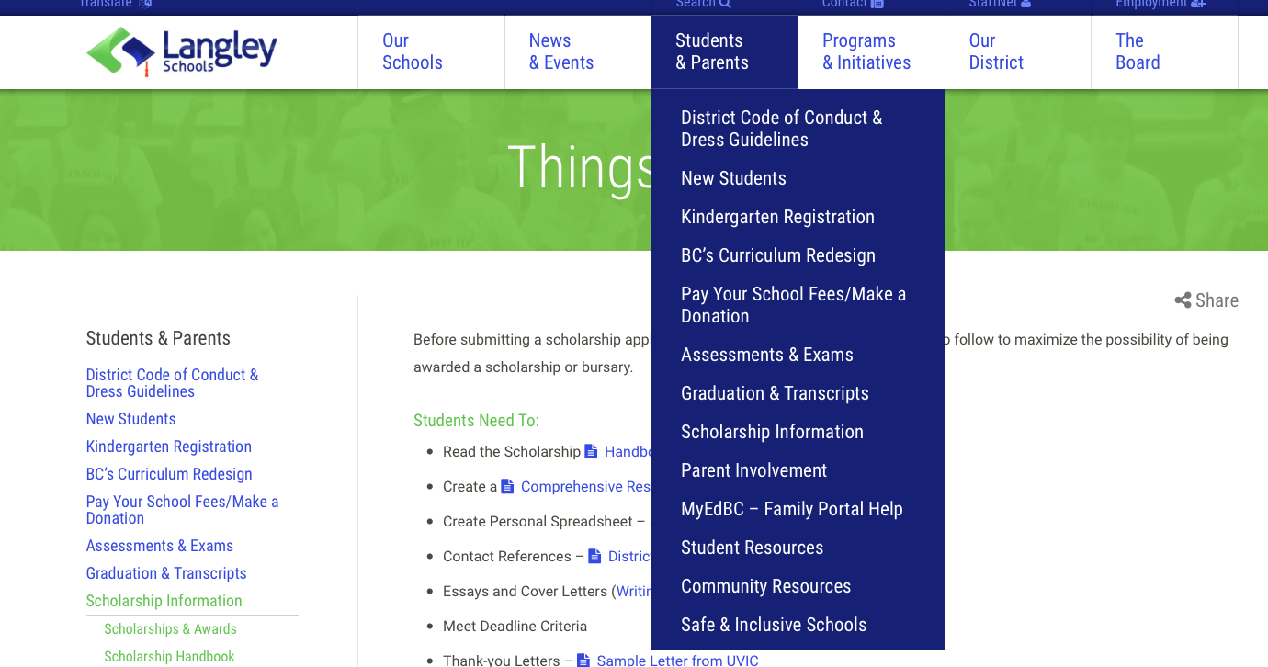


SCHOLARSHIP INFORMATION ON DISTRICT WEBSITE
www.sd35.bc.ca

Slide 41
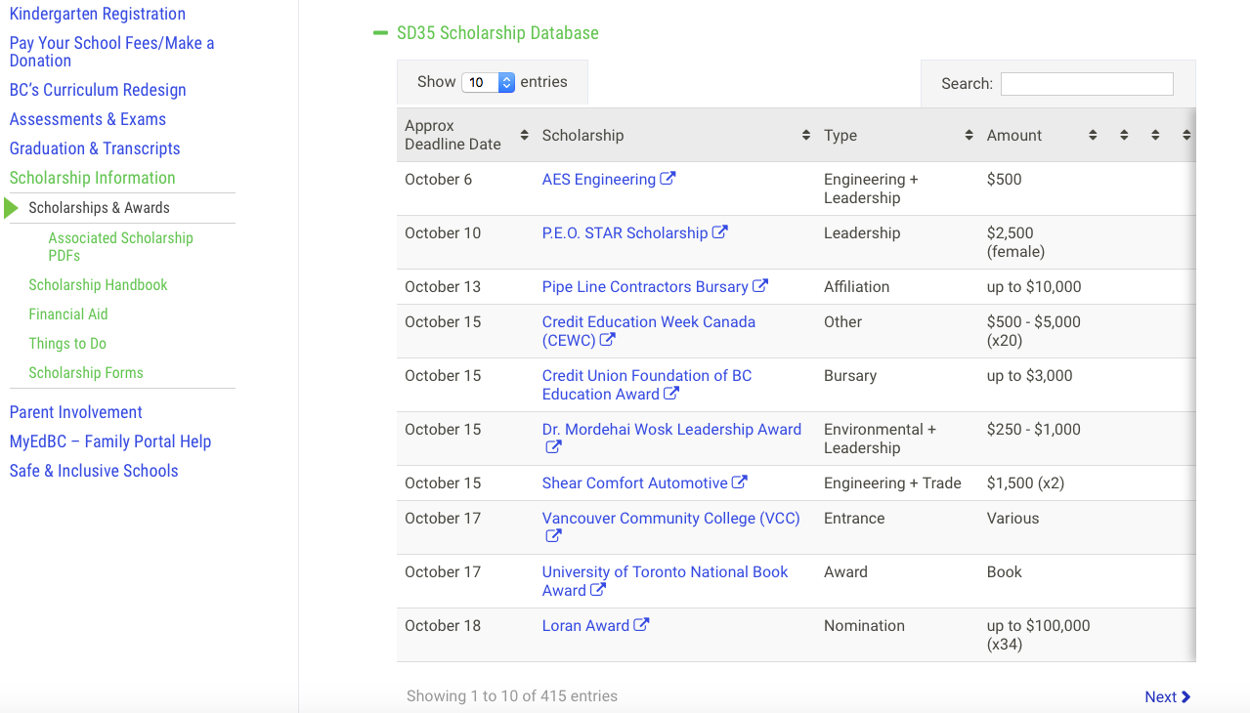

SCHOLARSHIP DATABASE
https://www.sd35.bc.ca/students-parents/scholarship-information/scholarships-awards/

Slide 42
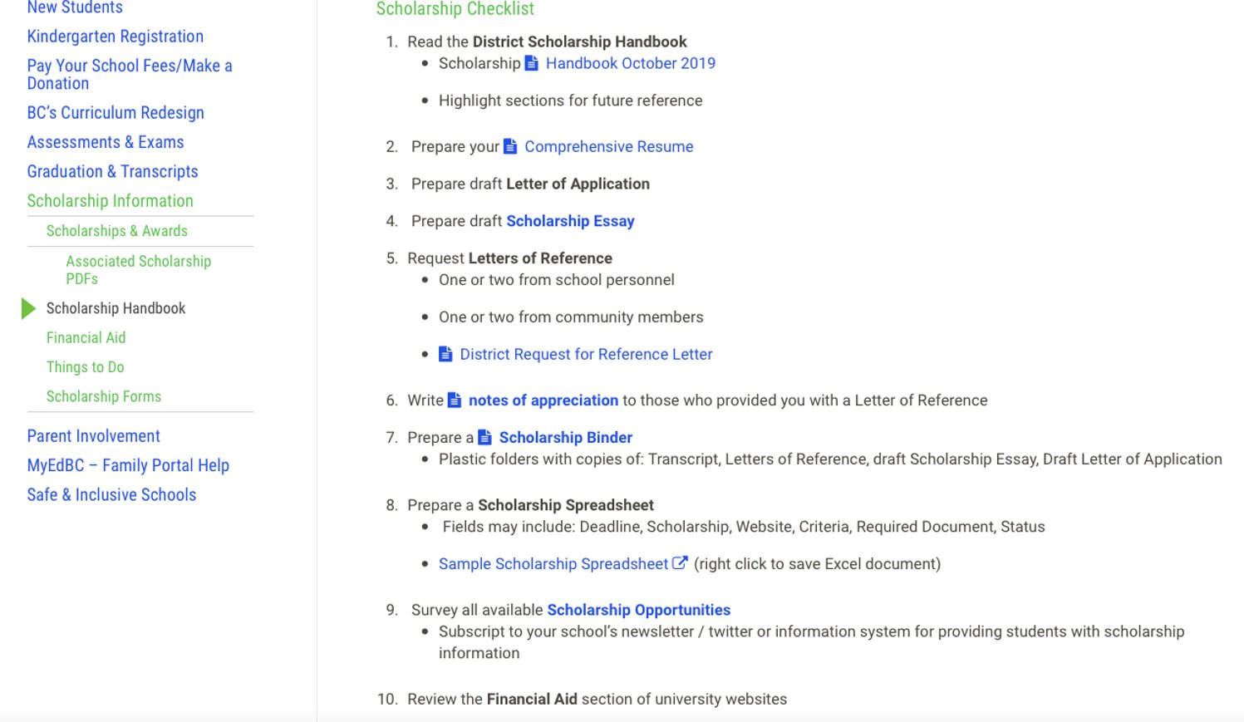


SCHOLARSHIP HANDBOOK AND DOCUMENTS FOR APPLICATION
https://www.sd35.bc.ca/students-parents/scholarship-information/scholarship-handbook/

Slide 43
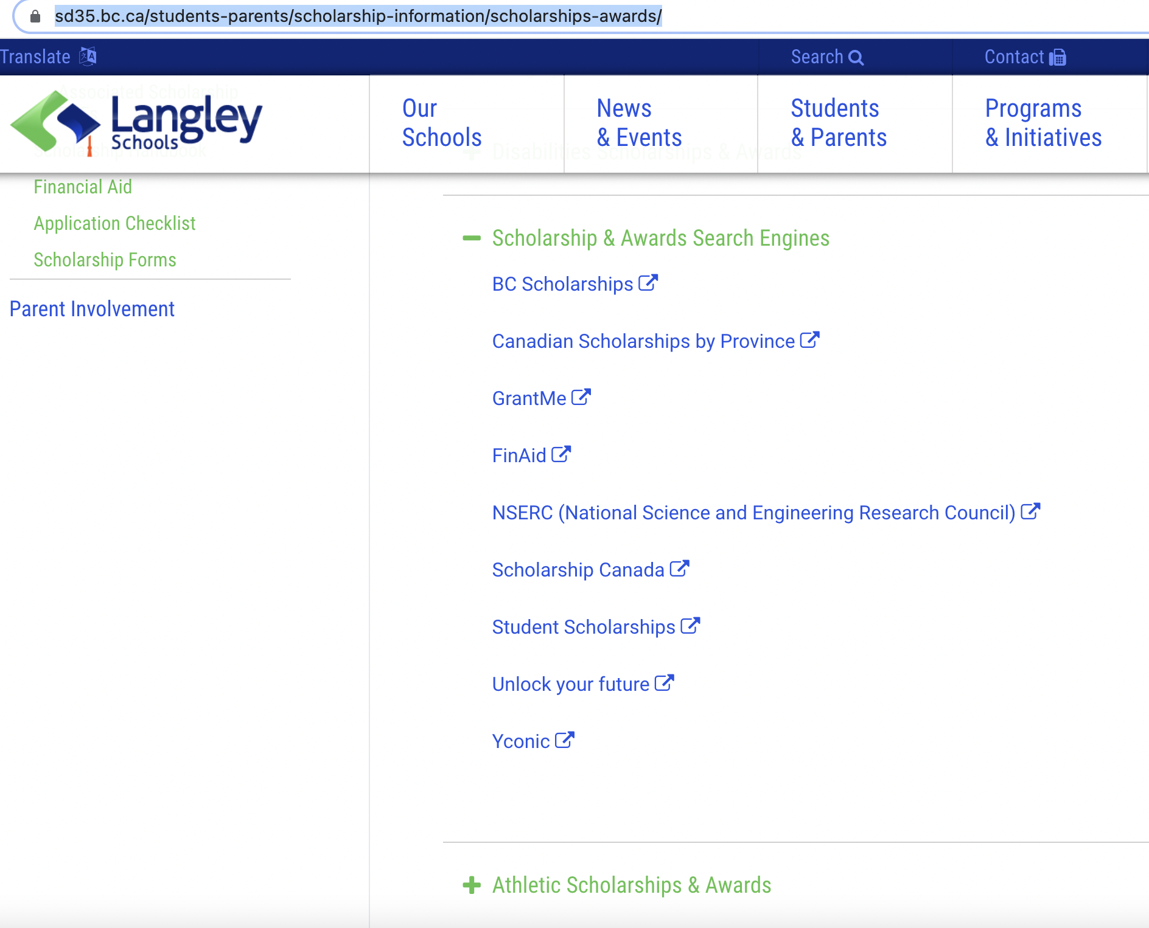
Other Resources for Financial Aid
Education Planner BC: https://www.educationplannerbc.ca/plan/finance/scholarship
Resources listed on District Website:
https://www.sd35.bc.ca/students-parents/scholarship-information/scholarships-awards/

Slide 44
Scholarship Application
In School Application
  One application for District Authority, Langley District Scholarships and LFAS Scholarships
  Application form will be available mid- January 2027 and due on Feb. 26, 2027
  Talk to Mr. Hofbauer for details
Out of School Application
  Nomination: talk to Mr. Hofbauer if you want to be nominated for the scholarship
  Send application directly to the scholarship provider: Schulich Scholarship, TD Leadership Scholarship
  Organize your applications based on the deadlines

Slide 45
Scholarship Application
Documents required
  In School Application
    LFAS Scholarship Application Package
    Reference Form (as part of the Application Package): please request this at least 1-2 weeks before deadline
  Out of School Application
    Application Form
    Essay
    Resume/personal Profile
    Reference letters
    Evidence of your achievements: copy of certificate, pictures, portfolio, articles/newspaper, etc
**Reference letters:
Teachers, Coach, Supervisors of work/volunteer, Community Members, who know you well (no family members).
Give them some information about yourself including transcript, future education plan, extra-curriculum activities, achievements, etc.
Request the letters 2-3 weeks before deadline.
Scholarship Handbook and Document Checklist on District Website

Slide 46
SCHOLARSHIP LUNCH ‘N’ LEARN
SEND MS. SEYMOUR A MESSAGE ON TEAMS WITH FOLLOWING INFO:
Which day is best for you
What you most want to know

Slide 47
Follow up Sessions
Send a message to Ms. Lee or Mr. Hofbauer on Teams if you are interested in attending a follow-up session on anything covered today.
Be sure to state your available blocks and what you want more information on.

Slide 48
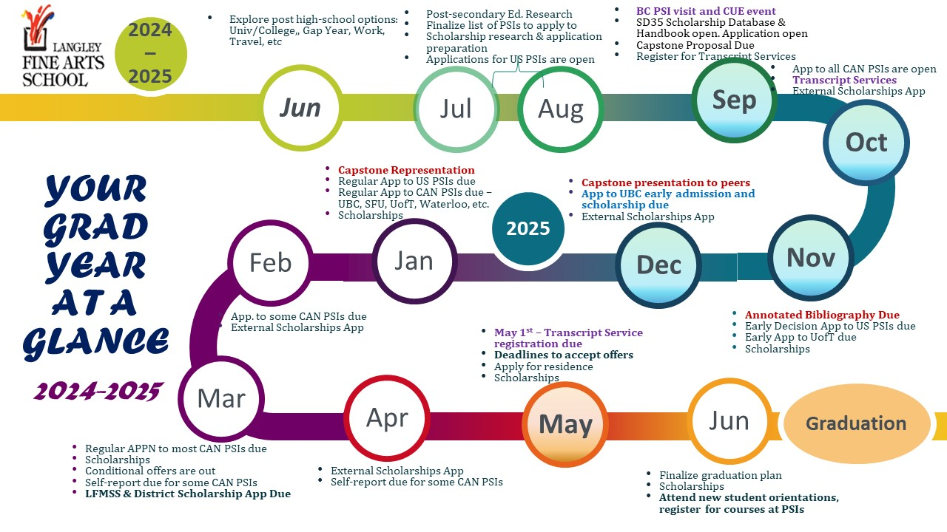

Slide 49
Questions?
Mr. Hofbauer: chofbauer@sd35.bc.ca
Ms. Lee: anne.lee@sd35.bc.ca
Or message through Teams

