Slide 1
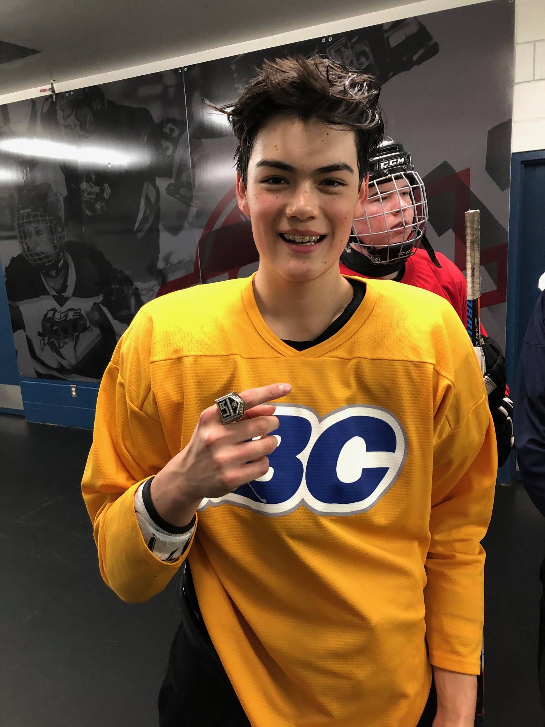
LSS Hockey Academy

Slide 2
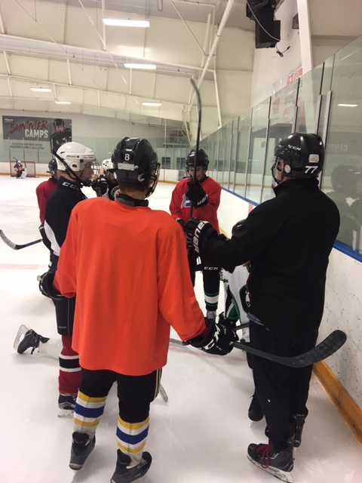
LSS Hockey Academy
Why a Hockey Academy?
We are strictly a skills-based academy and do not play against other teams
Students take the Academy in order to develop their individual skills
Students work on their skills during the class, unlike team practices where most of the time they are working on team concepts

Slide 3
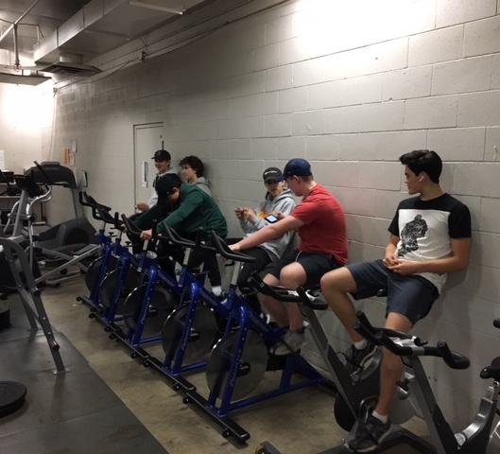
LSS Hockey Academy
What happens in Academy?
Players are on ice 2-3 times per week at Twin Rinks with Paul Whintors as the lead instructor (approx. 45 ice sessions)
Skating, Shooting, Puck Possession, Positioning, Situational
Players do off ice activities on the days they are not on the ice:
Fitness and Conditioning, Shooting and Stick Handling, Career Education, Film Analysis, Nutrition, Leadership and other activities

Slide 4
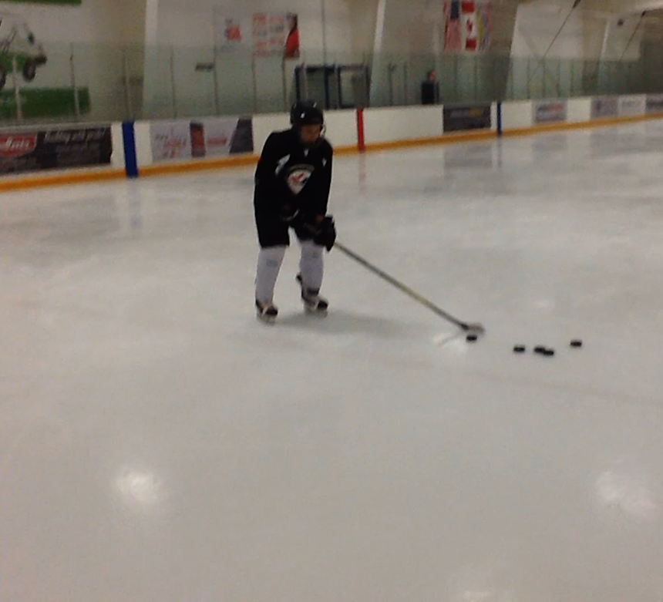
LSS Hockey Academy
What Credits do the students get for taking the Hockey Academy
Students will a PE Credit for whatever grade they are in.
What is the cost of the Academy?
The cost of the Hockey Academy will be $1000 for the semester (based on 20 students). This pays for ice rentals, instructor costs, Gym Memberships (New this season at fitness unlimited) and equipment

Slide 5
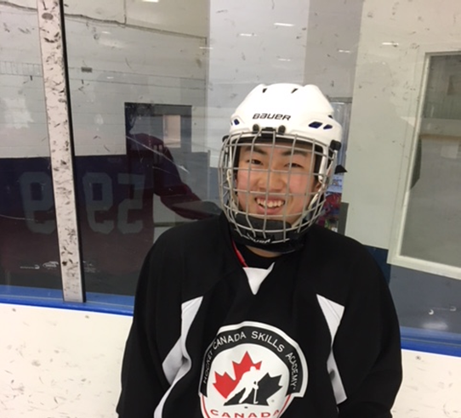
LSS Hockey Academy
How do students get their gear to and from the rink?
We have a room at Twin Rinks for the students to put their gear in before school and pick it up after school. Students walk to and from the rink for the class.
What Skill Level Does a student need to be?
Students of any playing ability are able to participate in the Academy as our purpose is to develop individual skills.
Will the academy interfere with other programs at the school?
The Academy should not interfere with other programs at the school.

Slide 6
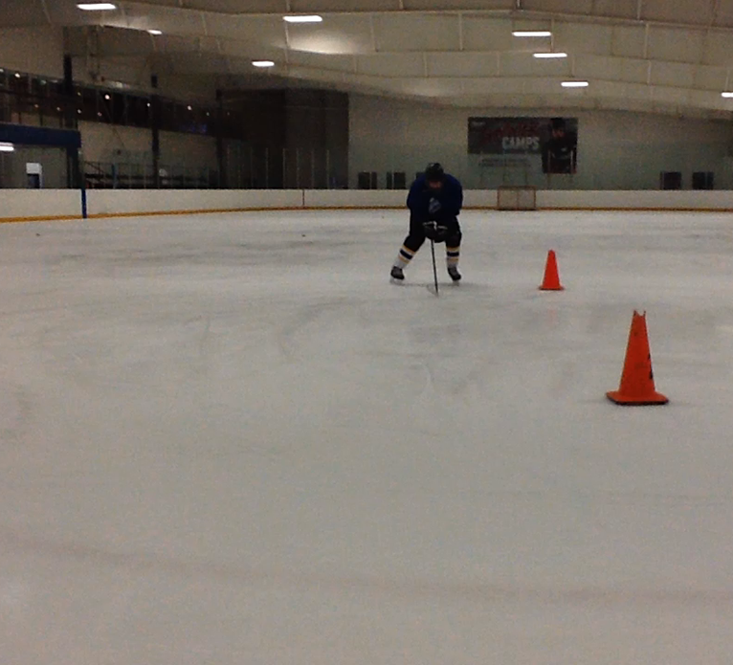
LSS Hockey Academy
How do students register for the Hockey Academy?
Students can register for the Hockey Academy when they do their course planning later in February. There is a specific section to choose the academy.
Students that are cross boundary to the school need to fill out the registration package provided tonight or can be picked up from the school office.

Slide 7
LSS Hockey Academy
Typical Week Based on Previous
Monday: 1, Flex (students leave for rink), Ice 10:30-11:30, Lunch, 3 and 4
Tuesday Ice 8:45-9:45, Flex (students return to school), 1, lunch, 3 and 4
Wednesday: 3, Flex, 4, Lunch, 1, Gym (dismiss for gym)
Thursday: 4, Flex, 3, Lunch (students go to gym), Gym, 1
Friday: Rotates with and ice time instead of gym or during regular ice time

Slide 8
LSS Hockey Academy
Breakdown of Costs
Ice Time (approx. 45)
Instructor
Gym Memberships (5 months, unlimited use)
Clothing
Equipment

Slide 9
LSS Hockey Academy
Contact Information
Troy Bannister
6045344171
tbannister@sd35.bc.ca
Twitter @AcademyLSS
Instagram @lssbaseballacademy

