Slide 1
After Youth TRAIN In Trades
June 2020

Slide 2
Agenda
Industry Training Authority (ITA)
Apprenticeship Pathway
Skills developed at each level
Apprenticeship Advisor
Youth WORK in Trades
Youth WORK in Trades Award ($1000)
Apprenticeship Incentive Grant (AIG) [up to $2000 for men, up to $6000 for women in underrepresented trades]
Apprenticeship Completion Grant (ACG) [$2000]

Slide 3
ITA - Apprenticeship Pathway
Go to itabc.ca or google ita bc
Click “Trades Programs”

Slide 4
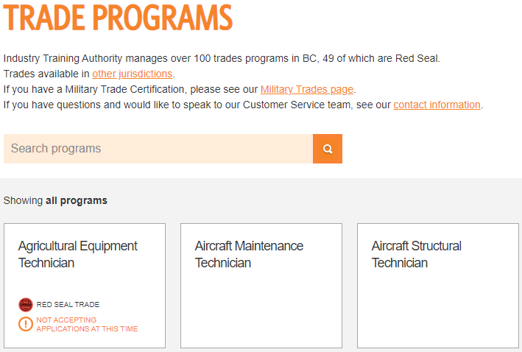
ITA - Apprenticeship Pathway
3. Select your trade

Slide 5
ITA - Apprenticeship Pathway
4. Download the Program Outline

Slide 6
ITA - Apprenticeship Pathway
5. It should look like this

Slide 7
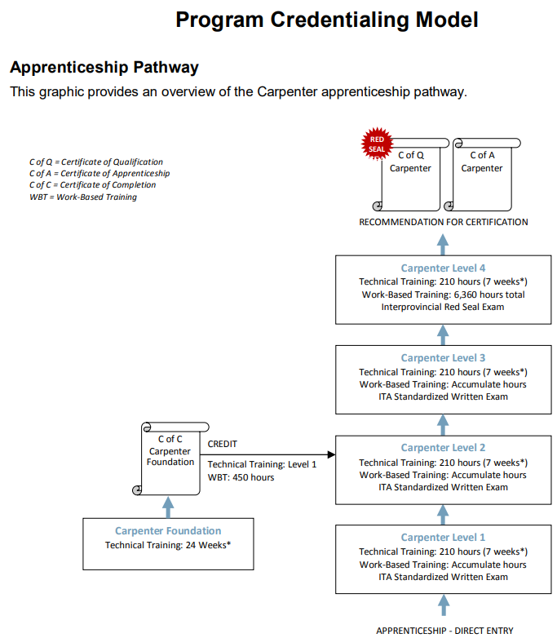
ITA - Apprenticeship Pathway
6. Scroll to the “Program Credentialing Model”
Carpenter

Slide 8
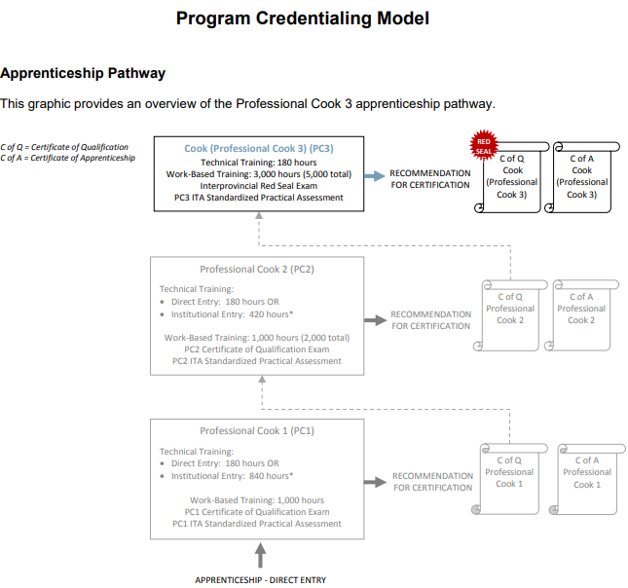
ITA - Apprenticeship Pathway
Cook

Slide 9
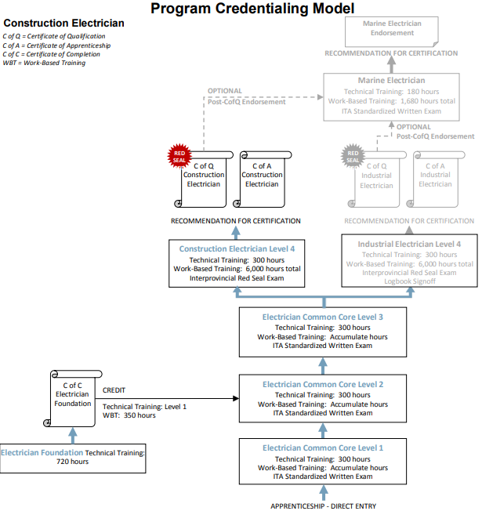
Construction Electrician

Slide 10
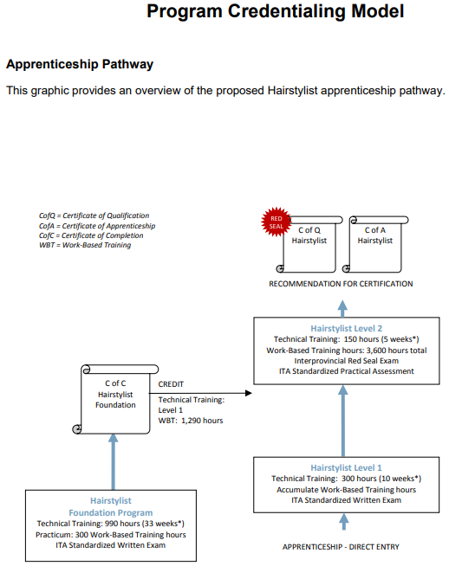
ITA - Apprenticeship Pathway
Hairstylist

Slide 11
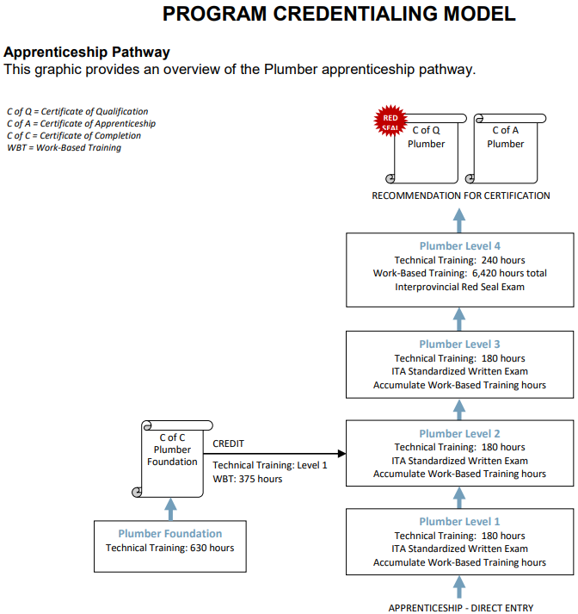
ITA - Apprenticeship Pathway
Plumber

Slide 12
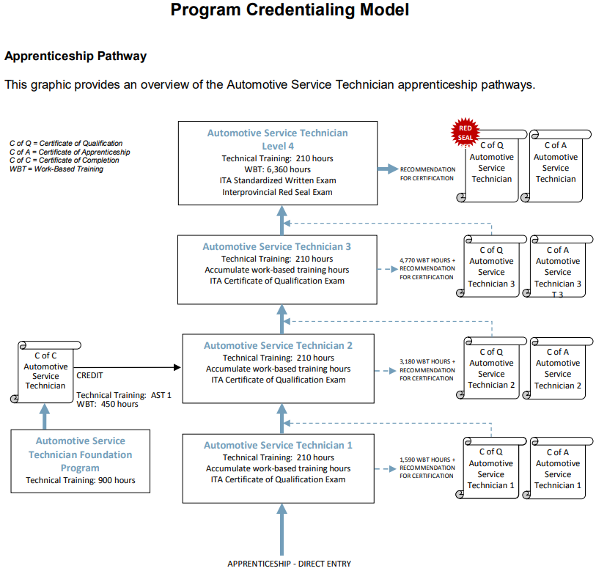
ITA - Apprenticeship Pathway
Automotive Service Technician

Slide 13
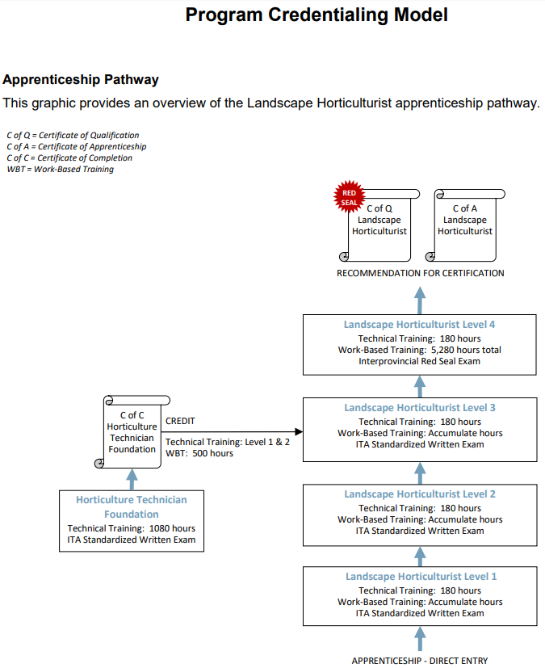
ITA - Apprenticeship Pathway
Landscape Horticulturalist

Slide 14
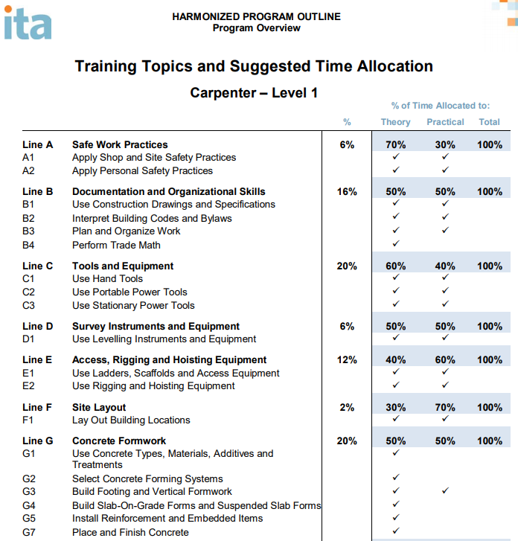
ITA - Skills developed at each level
7. Scroll down to “Training Topics and Suggested Time Allocation”
This is what, how long and how you’ll learn it (theory or practical) for Level 1 “Curriculum”

Slide 15
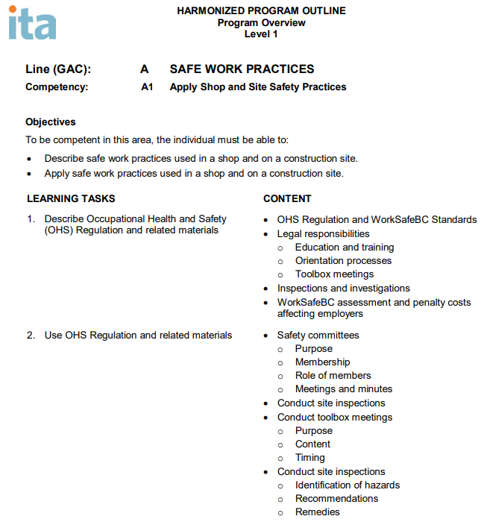
ITA - Skills developed at each level
7. Scroll down to the first “Program Content” section
This provides more details on what you’ll learn in Level 1. This is available for each item (A1, A2, etc.)

Slide 16
ITA - Apprenticeship Advisor
Go to itabc.ca or google ita bc
Scroll to the bottom of the page

Slide 17
ITA - Apprenticeship Advisor
Apprenticeship Advisors help employers and apprentices with all apprenticeship questions and concerns. You can also ask your Youth WORK/TRAIN in Trades teacher.

Slide 18
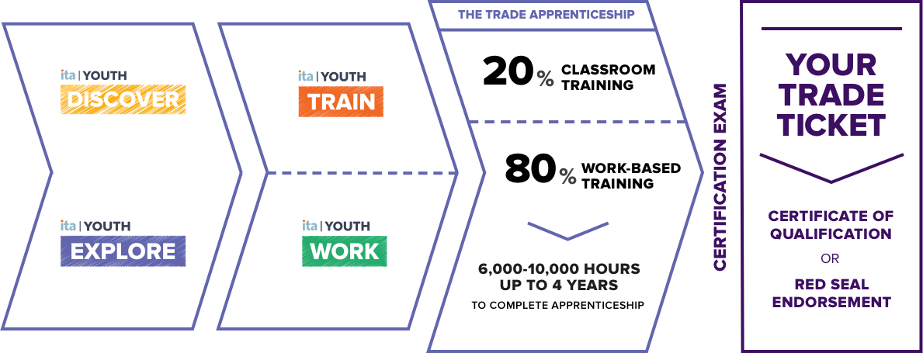
Youth WORK in Trades

Slide 19
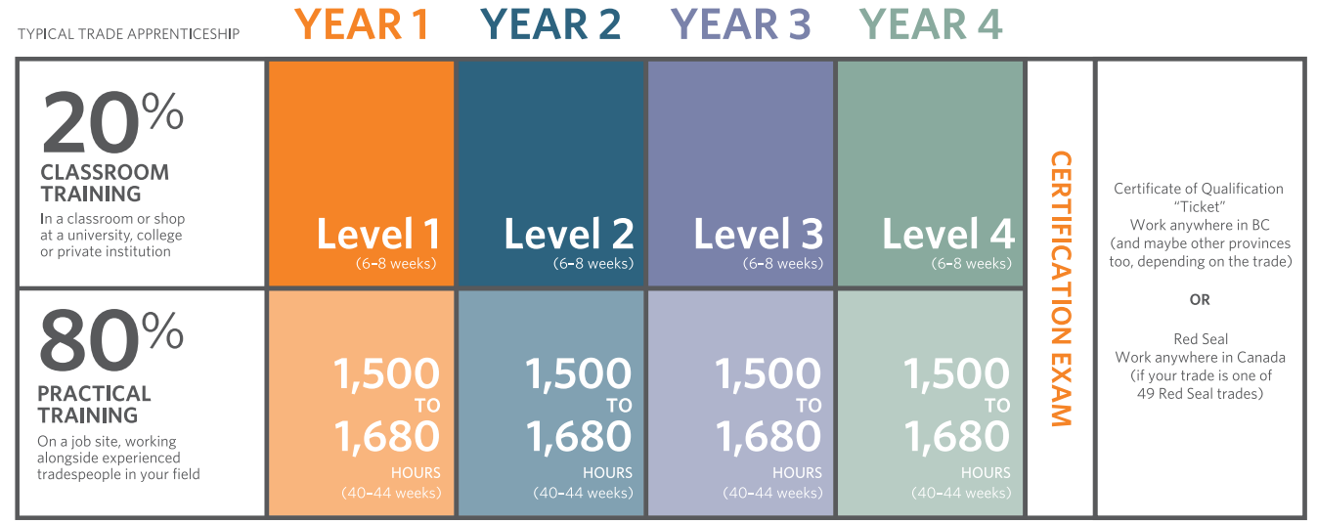
Youth WORK in Trades

Slide 20
Youth WORK in Trades

Slide 21
Youth WORK in Trades - Benefits
earn 16 elective credits towards graduation (equals 4 courses)
1 course = 120 Work-Based Training Hours x 4 courses
WRK 11A, WRK 11B, WRK12A, WRK12B
acquire skills employers want
get a head start on your career
have a seamless transition from school to work
use 480 paid work hours towards your apprenticeship
may become eligible for a $1000 Youth WORK in Trades Award

Slide 22
Youth WORK in Trades - Requirements
To be considered for the Youth WORK in Trades Apprenticeship Program, students must:
have parent or guardian permission
be 14-19 years old – can be graduated already
are working or have worked in an ITA regulated trade
have a Certified Tradesperson as a sponsor
Note: WBT Hours earned in a youth apprenticeship (Youth WORK in Trades) will convert to an adult apprenticeship automatically when you turn 20)

Slide 23
Youth WORK in Trades – How it works
Talk to your Career Advisor/Counsellor/Youth WORK in Trades teacher and Employer
Complete Youth WORK in Trades Registration Form
Student registered as an LEC student (you don’t have to go there)
Work on course assignments online on Workplace Safety and employment skills (2-5 hours)
SD35 Staff will visit the employer/work site
Employer checked for safety, Training Plan developed, Registration forms signed,
Registration will be submitted to the ITA to make students youth apprentices
Student is monitored by Youth WORK in Trades teacher (text message/email)
Final mark assigned based on # of hours completed

Slide 24
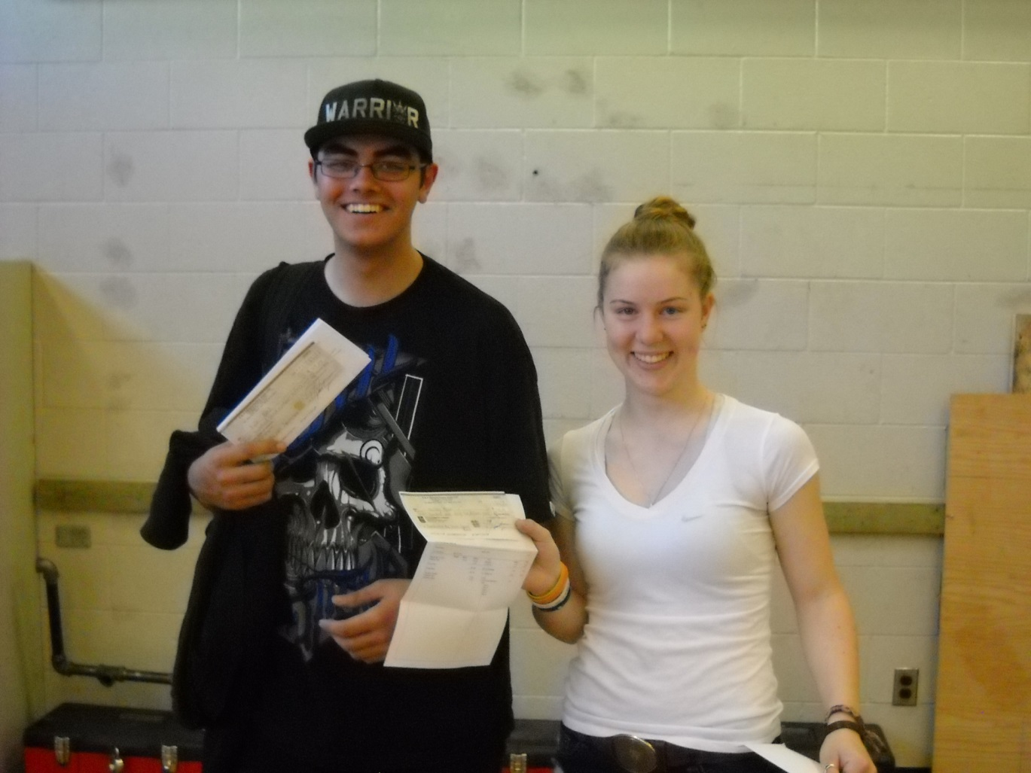
Youth WORK in Trades - $1000 Award

Slide 25
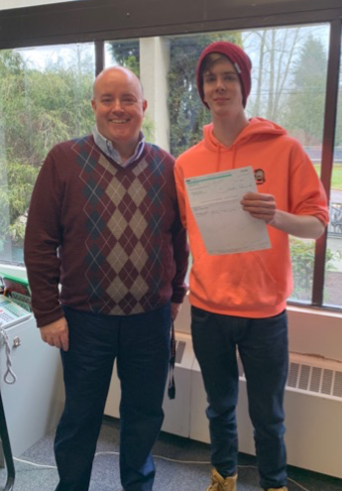
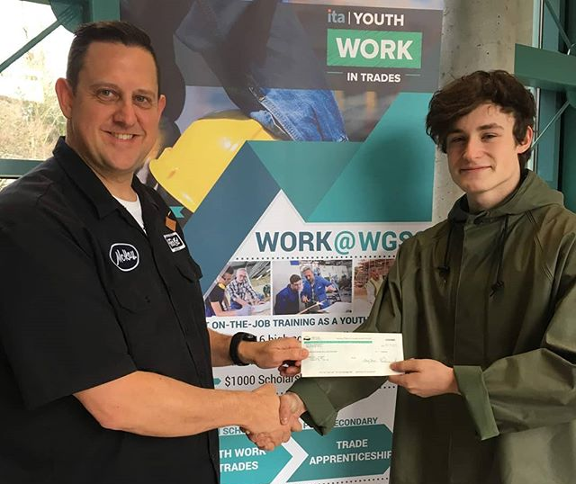

Slide 27
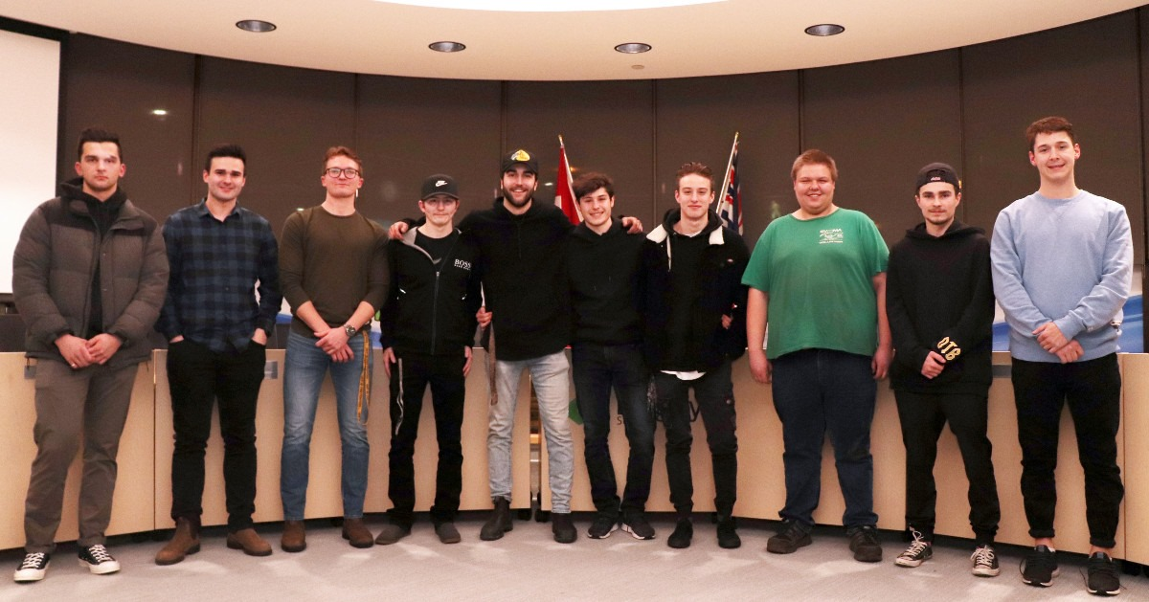

Slide 28
$1000 Youth WORK in Trades Award
There is no need to apply. To be eligible, students must have:
Been registered with the Industry Training Authority as a Youth Apprentice
Graduated with a Grade 12 Dogwood Diploma or Adult Dogwood
Successfully completed WRK 11A, WRK 11B, WRK 12A, and WRK 12B
Maintained a C+ average or better on Grade 12 numbered courses
Reported a total of at least 900 hours to the ITA by December 31 of the school year the student turns 19

Slide 29
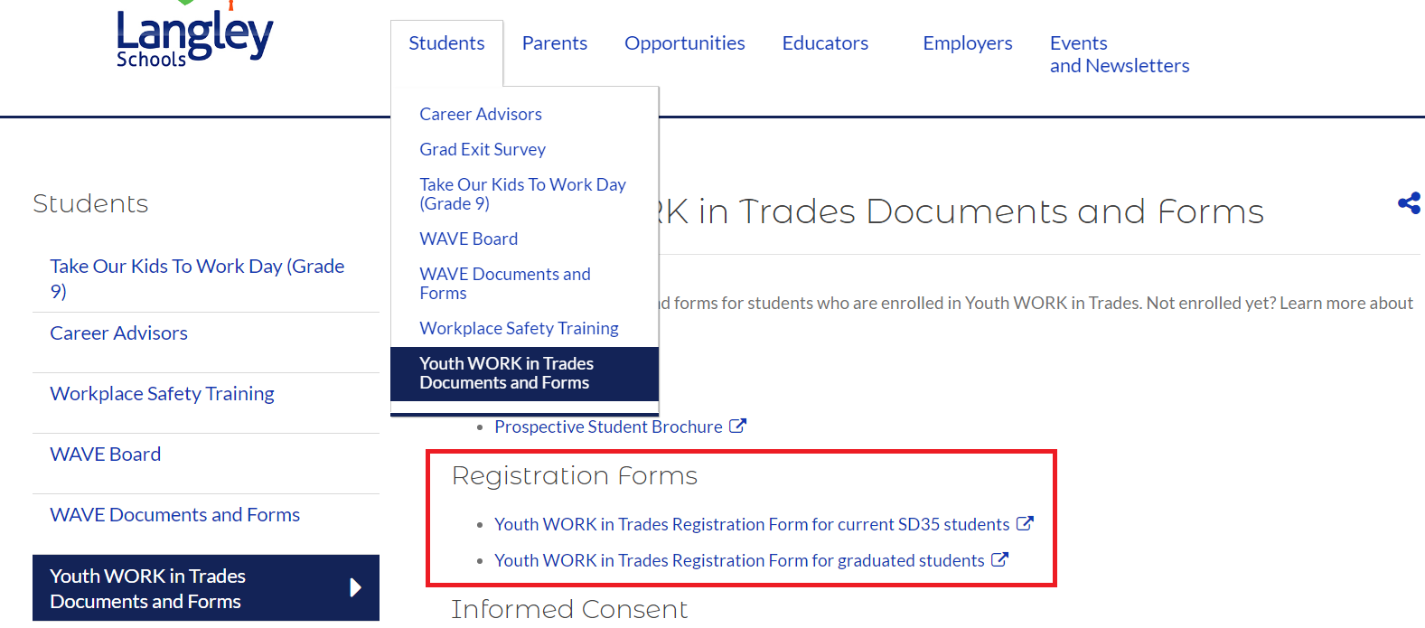
Ready to register for Youth WORK in Trades?
Go to careered.sd35.bc.ca/youthworkdocs
Complete the Registration Form at the bottom of the page

Slide 30
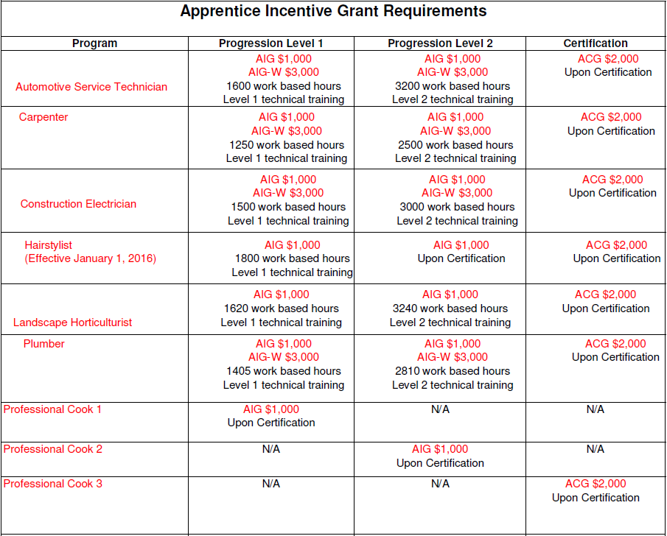
Apprenticeship Incentive Grant (AIG) and Apprenticeship Incentive Grant (AIG)
Requires the apprentice to apply after meeting the requirements
Google: Canada apprenticeship grant
Apply online within 12 months of receiving “Confirmation of Progression Letter” from the ITA

Slide 31
Tax credits for non-Red Seal/ITA BC trades
Tax credits may be claimed when completing income tax return in the tax year when the level was completed

Slide 32
Questions?

Slide 33
Contact:
Geoff McSherry
Career Education District Teacher
Langley School District
Phone (no text): 778-726-4529
Cell (text/sms): 778-744-0066

